Slide 1
Introduction to Cost of Living Analysis
The cost of living is a crucial metric that impacts individuals and businesses alike. Understanding the cost of living in different cities and countries is vital for making informed decisions regarding relocation, investment, or business expansion.
By harnessing the power of Power BI, we aim to gain valuable insights into the economic disparities between different regions and understand the factors that contribute to the varying costs of living.

Slide 2
Cost of Living Analysis
Dataset Details:
The dataset utilized in this project is sourced from Numbeo, a collaborative online database that provides cost of living information worldwide. It contains 56 columns, including information about cities,countries, and a wide array of cost-related variables, ranging from grocery prices to real estate costs.
Dataset starting from city, country to some basic amenitities.
Data steps
Load data in power bi
Data cleaning and transformation,
Data visualization like Making dashboard/reports
Slicer used
City
Country
category

Slide 3
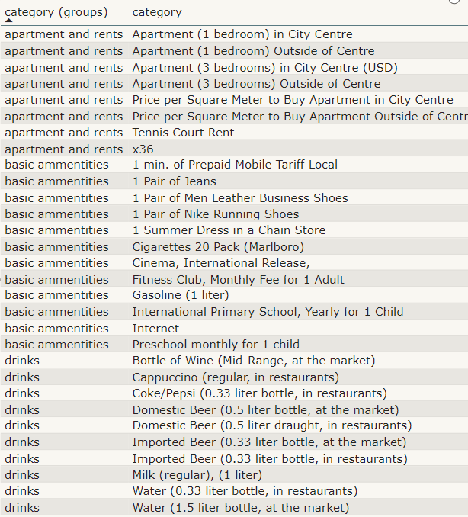
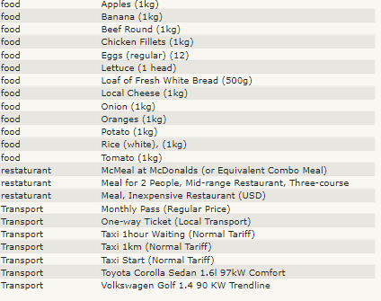
Cost of Living Analysis
Dataset overview
I divide 55 subcategories column in one each categories

Slide 4
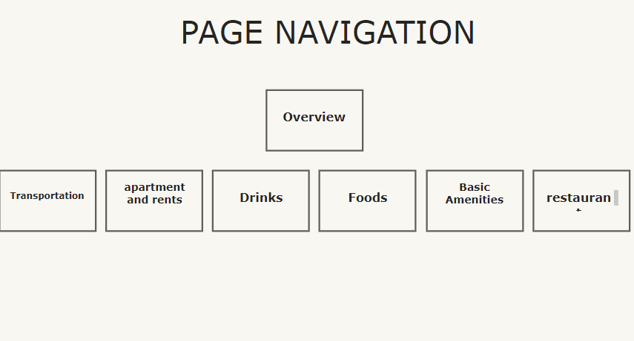
Cost of Living Analysis

Slide 5
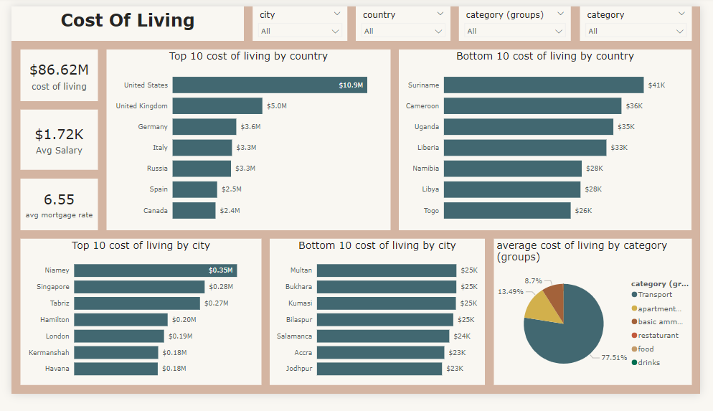
Overview Cost of Living Analysis
The mortgage rate is average around 6.5%
United states is more expensive that why cost of living is more there
Transportation cost of living is use most of percentage followed by apartment

Slide 6
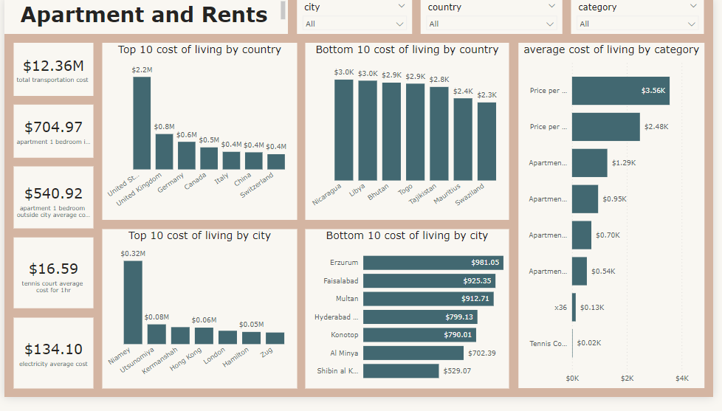
Cost of Living Analysis
Apartment cost is more in united states followed by UK
Price for room in city is more that outside city same for apartment 3bhk and 1bhk

Slide 7
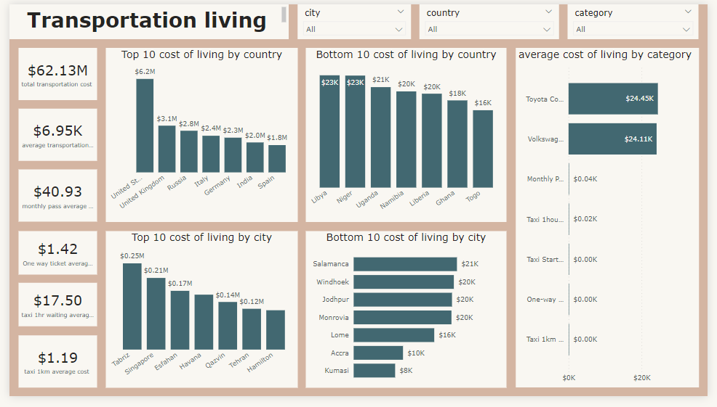
Cost of Living Analysis
Transportation cost of living is use most of area in cost of living
For one way ticket $1.42 price is there
United states is expensive for transportation , to use public vehicle is less expensive that private vehicle can be correlated with price of petrol

Slide 8
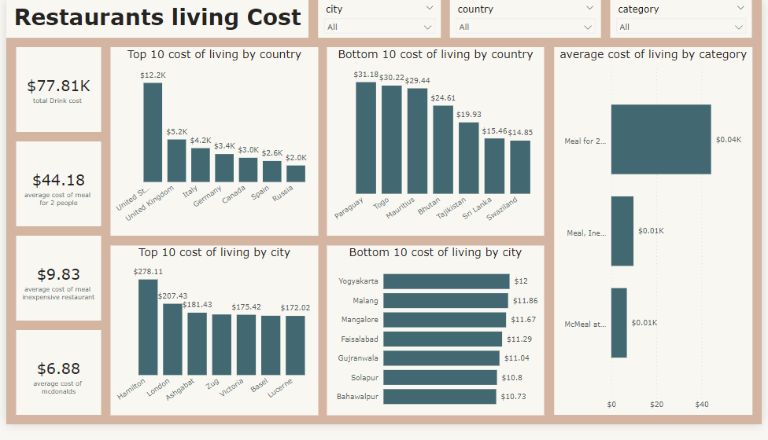
Cost of Living Analysis
People mostly prefer to eat meal for mcMeal where price is less
Price for 2 meal person is more

Slide 9
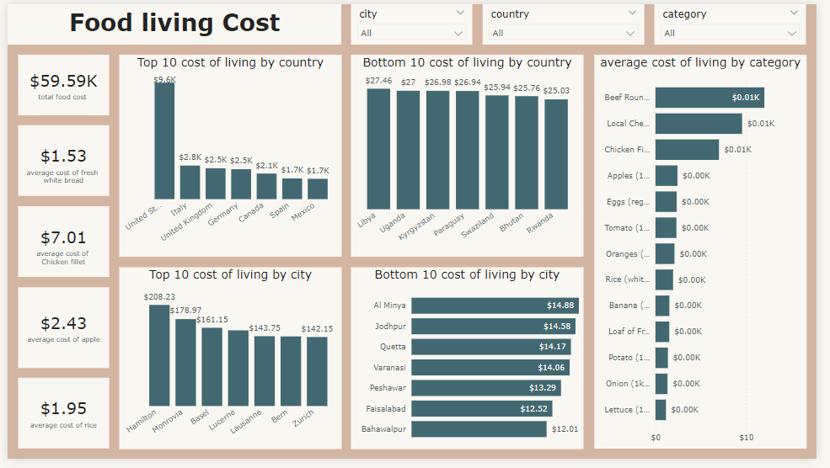
Cost of Living Analysis
Price of meat has cost of price more that fruits and vegetables
Lettuce has lowest price of cost

Slide 10
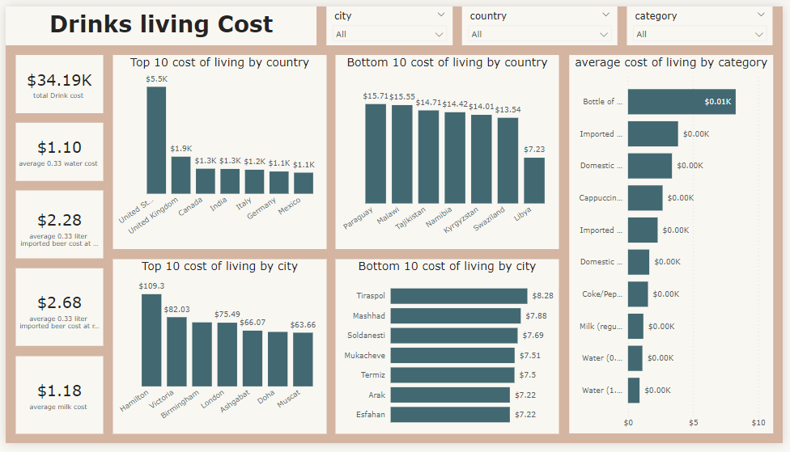
Cost of Living Analysis
Water is less expensive in drink
Drinks in restaurant is expensive rather than buying drinks from market , we can correlated with tax restaurant apply tax on drinks
Imported bear cost is more than domestic bear in market

Slide 11
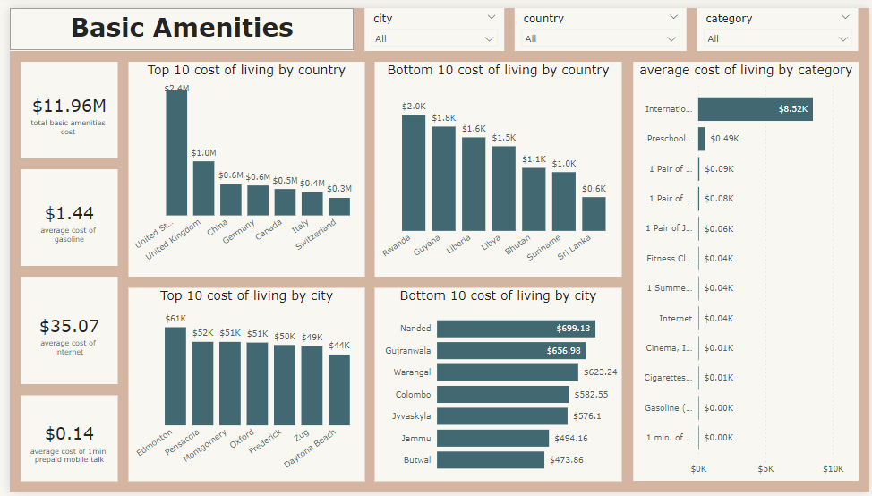
Cost of Living Analysis
Most of cost of living is more for school children’s fees
Lest cost of living is mobile talk time for 1 minute for basic amenities

Slide 12
THANK YOU

